Slide 1

Breast Cancer Prediction
By: Raaga Sindhu
and
Harika Mangu

Slide 2
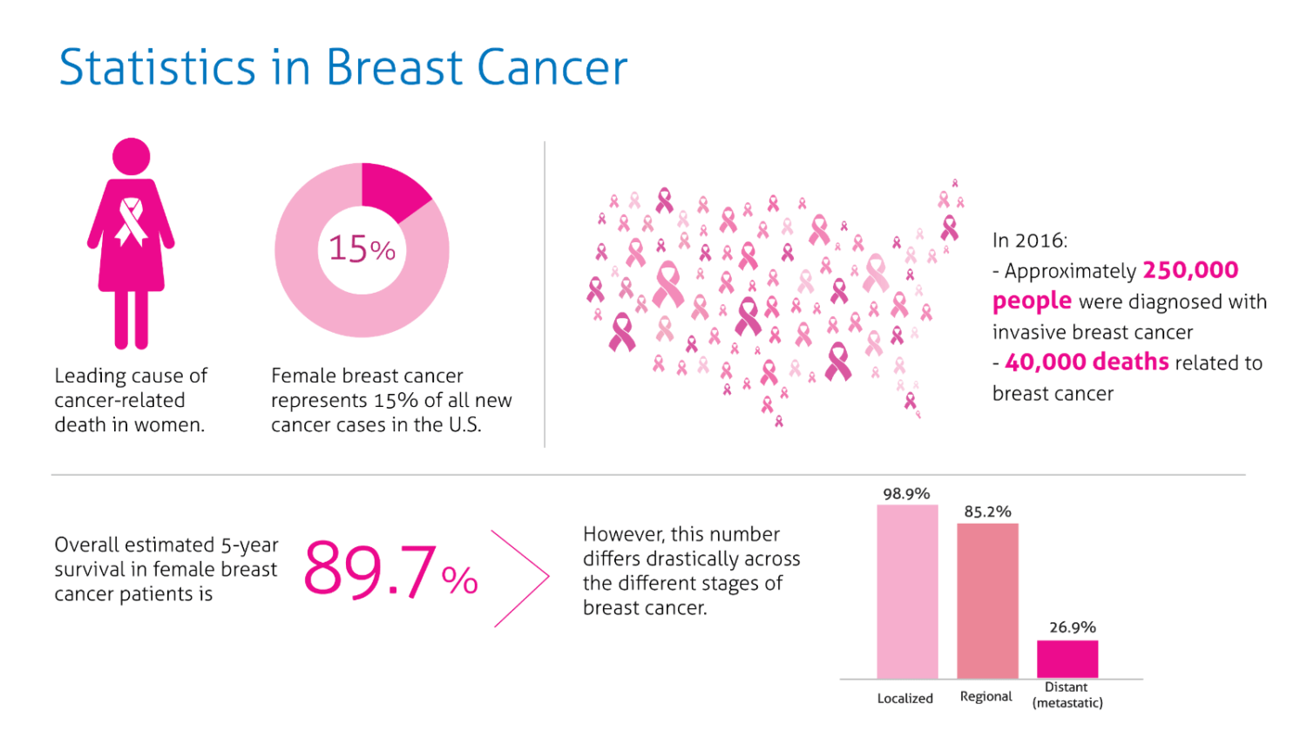
Project selection and problem definition
Breast cancer is a deadly disease that affects one in eight women and results in around 40,000 deaths annually in the US alone. Unfortunately, breast cancer can go undetected until later stages due to a lack of symptoms, making early detection crucial. To address this problem, we propose to build a machine learning model that can predict the likelihood of a patient developing breast cancer based on a set of demographic, medical history, and medical imaging data. The model should be able to handle missing or incomplete data and classify tumors as either malignant or benign. Additionally, the model should provide insights on the most important features that contribute to the prediction and be interpretable. By identifying high-risk individuals and providing necessary interventions, we hope to improve early detection and prevention of breast cancer, leading to better outcomes for patients.

Slide 3

Data Collection and Description
We obtained the breast cancer dataset from Kaggle, which includes 570 patient records with 32 attributes. Out of these, 30 attributes contribute as predictors, while the attribute "diagnosis" serves as the response variable. Each patient record has a unique ID, which acts as a primary key and is not a predictor or response variable.
The predictors include features such as radius_mean, texture_mean, perimeter_mean, area_mean, smoothness_mean, compactness_mean, concavity_mean, concave points_mean, symmetry_mean, fractal_dimension_mean, radius_se, texture_se, perimeter_se, area_se, smoothness_se, compactness_worst, concavity_worst, concave points_worst, symmetry_worst, and fractal_dimension_worst.
Symptoms of breast cancer can include a lump or thickening in the breast tissue, changes in the size or shape of the breast, and changes to the skin on the breast such as redness or dimpling.
Our goal is to use this dataset to build a machine learning model that accurately predicts the likelihood of a patient developing breast cancer. We will also explore the most important features that contribute to the prediction and aim to provide insights on how to improve early detection and prevention of breast cancer.

Slide 4
Data exploration
List of Predictors:
- The dataset we are working on contains various measurements related to breast cancer diagnosis. It consists of 30 attributes or features which can be used as predictors. These attributes provide information about the size, texture, shape, and smoothness of the tumor. Understanding what each attribute represents helps make a decision about feature selection and model performance evaluation.
Exploratory Data Analysis:
- We can calculate the correlation matrix of the dataset to determine which attributes are highly correlated and could be useful in predicting breast cancer. The correlation matrix shows the correlation coefficient between each pair of attributes, and we can find potential attributes for better prediction. A value of 1 indicates a positive correlation, 0 indicates no correlation, and -1 indicates a perfect negative correlation. Values greater than 0.7 are considered highly correlated. Next, we found the correlation of these highly correlated variables with the response variable (diagnosis) to determine the targeted variables responsible for our prediction. This process helps us identify the most important features for building an accurate predictive model.

Slide 5
Visualization
We used the corr() function to generate a correlation matrix for the first 10 attributes and plotted it as a heatmap using seaborn.
Highly correlated attributes were identified by segregating values above 0.7.
The same steps were repeated for the second 10 and last 10 attributes.

Slide 6
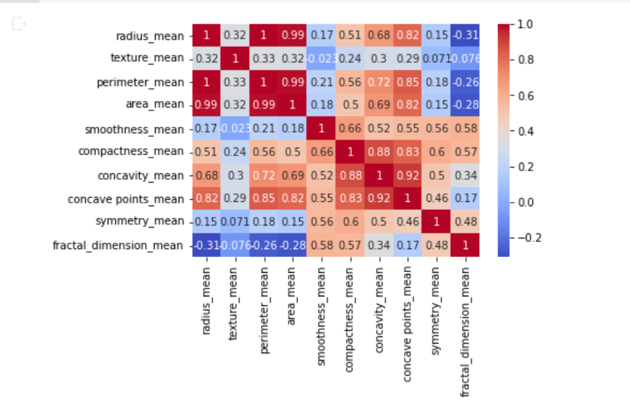
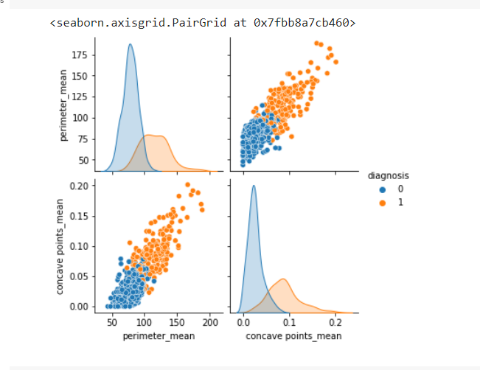
After comparing all the values, the columns which have the highest correlation values among first 10 attributes are “perimeter_mean” and “concave_points_mean”.
Hence, we have plotted a pair plot of these columns to check the malignant and benign data points, in order to crosscheck the correlation concept.

Slide 7
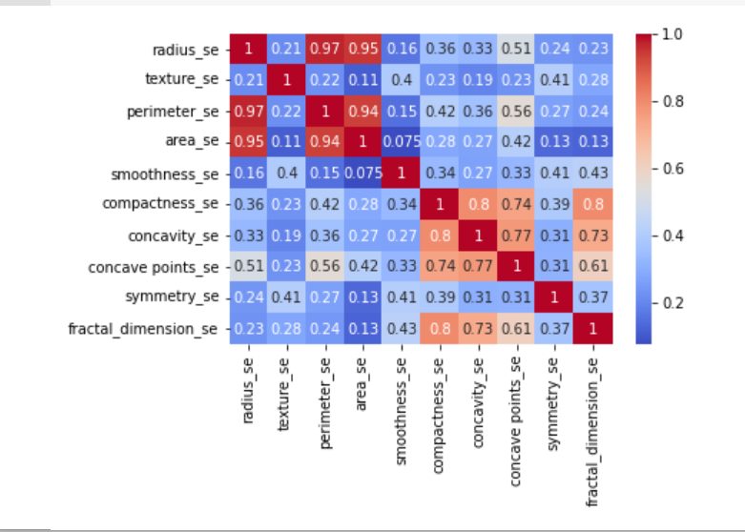
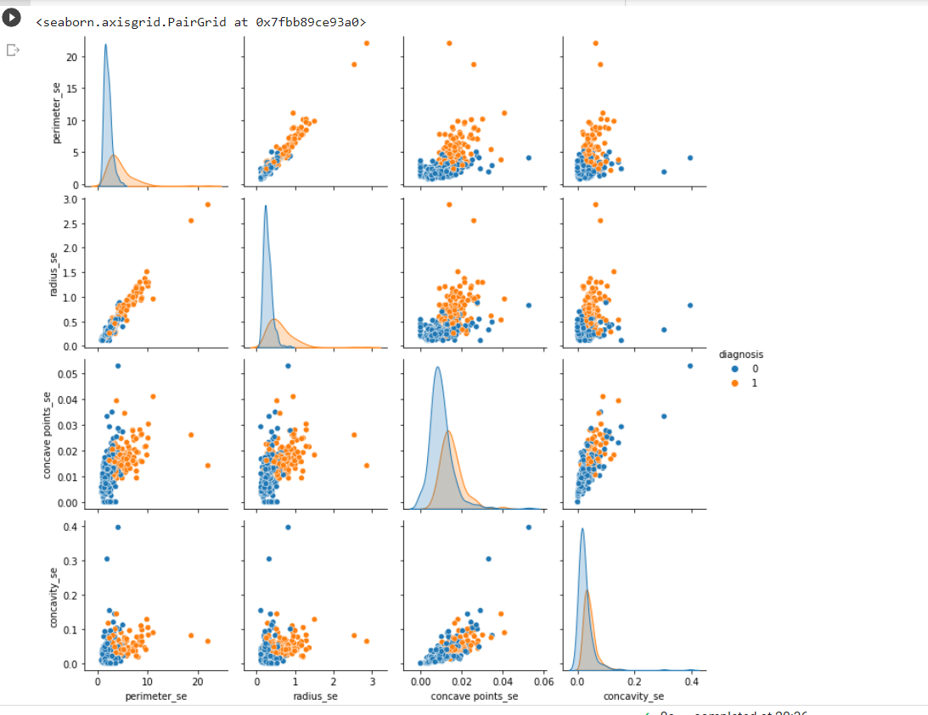
The same steps have been repeated for the next 10 attributes and the most correlated have been – “perimeter_se”, “concave_points_se” and “concavity_se”

Slide 8
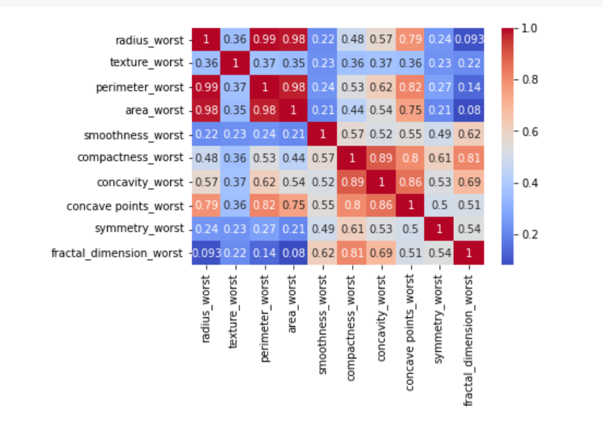
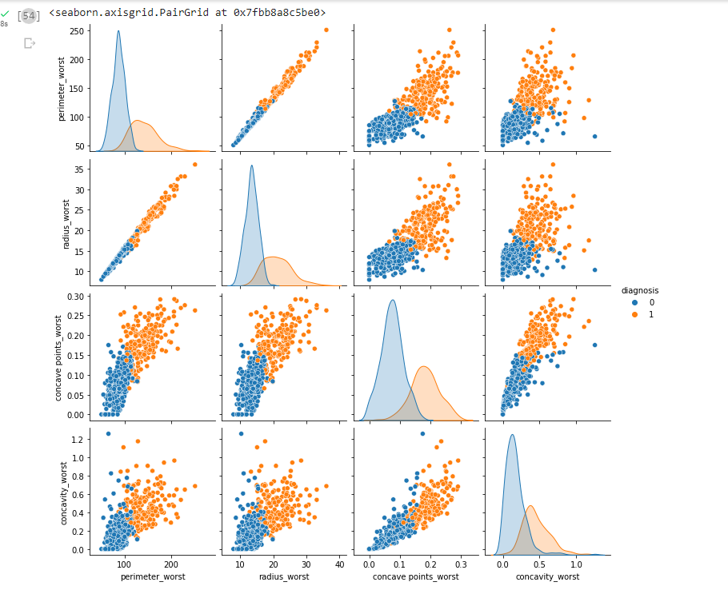
And for the last set of attributes, “perimeter_worst”, “radius_worst”, “concavity_worst” and “concave_points_worst” are the highly correlated attributes as can be seen from the visualizations.

Slide 9
Dimension Reduction
Dimension reduction techniques such as Principal Component Analysis (PCA) or t-distributed Stochastic Neighbor Embedding (t-SNE) are commonly used to reduce the number of features in a dataset while retaining most of the information. This can be useful in cases where the dataset has a large number of features, which can make training machine learning models computationally expensive and prone to overfitting.
However, in the case of the breast cancer dataset, the number of features is relatively small (30), and these features have already been selected based on their importance in predicting breast cancer. Therefore, performing dimension reduction techniques may not provide much benefit in this case and may even result in some loss of information.
Moreover, dimension reduction techniques can make it difficult to interpret the underlying relationships between the features and the target variable, which can be important in the medical domain where understanding the factors that contribute to the development of breast cancer is crucial. Therefore, it is advisable to carefully consider the trade-offs between reducing the number of features and retaining the interpretability of the dataset before deciding whether or not to perform dimension reduction.

Slide 10
Why haven’t we removed one of the highly correlated attributes?
If there are attributes that are highly correlated, it is often a good practice to remove one of them to avoid multicollinearity, which can lead to unstable and unreliable model performance. However, the decision to remove a highly correlated attribute depends on the specific problem at hand and the performance of the machine learning model with and without the attribute.
In the case of the breast cancer dataset, we have identified highly correlated attributes and used them to build a machine learning model. However, we have not removed any of the highly correlated attributes because they provide important information about the tumor's size, shape, and texture, which are critical factors in predicting breast cancer. Removing any of these attributes could result in a loss of important information and potentially degrade the performance of the machine learning model. Therefore, it is important to carefully consider the impact of removing a highly correlated attribute on the model's performance before making any decisions.

Slide 11
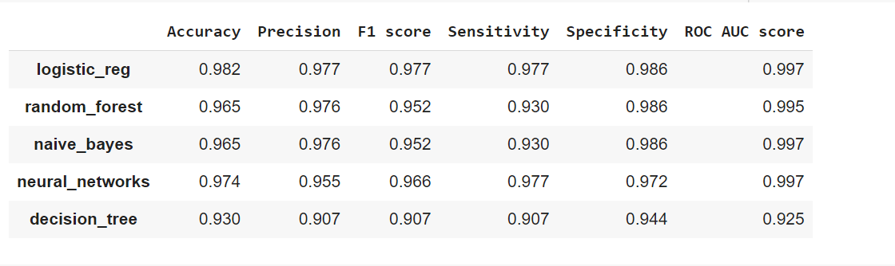
Model preprocessing and exploration
Preprocessed the Breast Cancer dataset by cleaning, normalizing, and performing feature selection.
Split the dataset into training and test sets, with a ratio of 80-20.
Evaluated the performance of six popular data mining models: Logistic Regression, Decision Trees, Random Forests, Support Vector Machines (SVMs) and Naive Bayes.
Compared the performance of each model using metrics such as accuracy, precision, recall, F-1 score, sensitivity, specificity, and ROC AUC score.
Selected the two best-performing models: Logistic Regression and Naive Bayes.

Slide 12
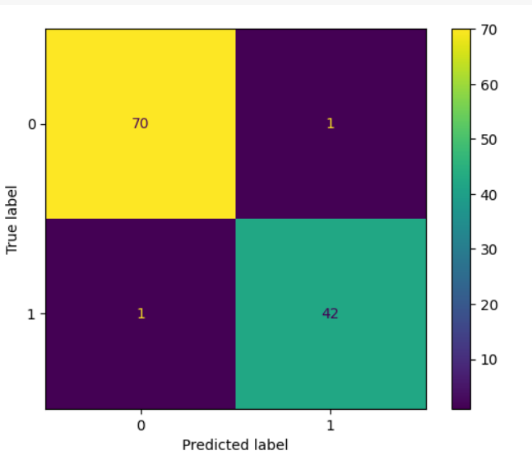
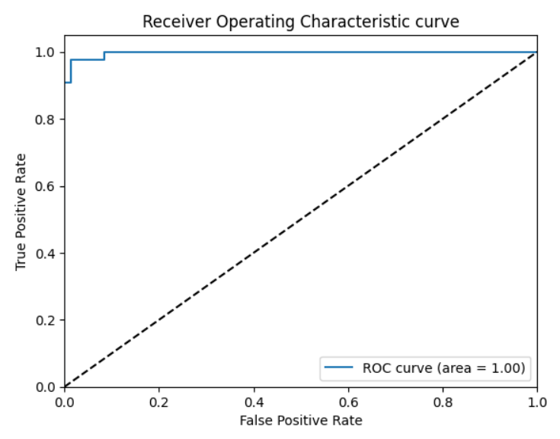
Model Selection
Logistic Regression:
A popular model for binary classification tasks
Provides interpretable results in the form of coefficients
A relatively simple and fast algorithm that can be trained quickly on large datasets
Robust to noisy or incomplete data and less sensitive to outliers than other models
Effective in predicting breast cancer risk based on various features
Achieves high performance with an accuracy of 0.94
Performance metrics: accuracy- 0.982, precision-0.97, F1 score- 0.977, sensitivity-0.977, specificity - 0.986, roc auc score-0.997
Confusion Matrix: [70 1; 1 42]

Slide 13
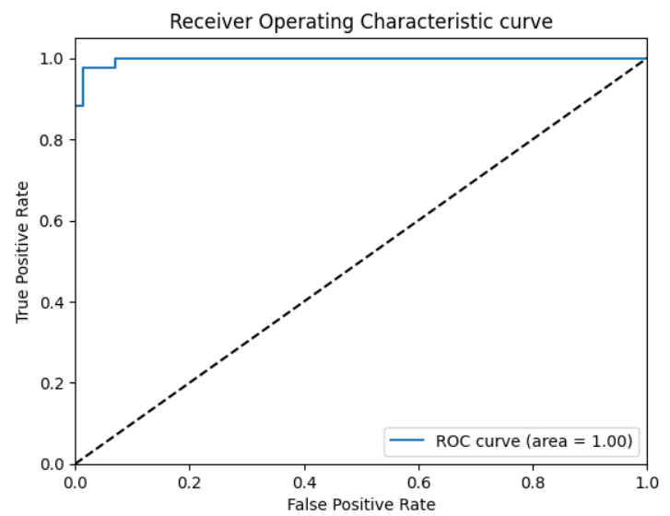
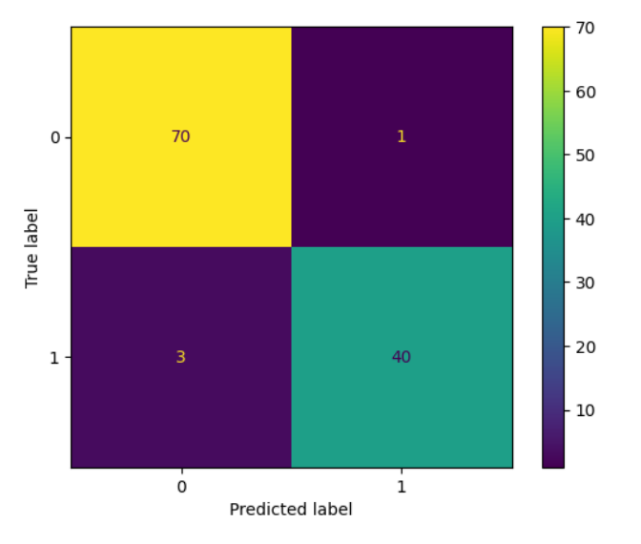
Naïve Bayes:
Another commonly used technique for binary classification tasks
A simple and fast algorithm that can be trained quickly on large datasets
Performs well on high-dimensional data such as medical images and gene expression data
Robust to irrelevant features, meaning that it can still perform well even when there are many irrelevant features
Achieves high performance with an accuracy of 0.965
Performance metrics: accuracy - 0.965, precision-0.976, F1 score-0.952, sensitivity - 0.93, specificity - 0.986, roc auc score- 0.997
Confusion Matrix: [70 1; 3 40]

Slide 14
Reason to choose Logistic Regression
We chose logistic regression as the final model for breast cancer prediction due to several reasons:
Interpretability: Logistic regression provides interpretable results in the form of coefficients that indicate the strength and direction of the relationship between each input feature and the predicted outcome. This can be important in medical applications where understanding the reasoning behind the predictions is necessary
Low complexity: Logistic regression is a relatively simple and fast algorithm that can be trained quickly on large datasets and is less prone to overfitting than some other models.
Robustness: Logistic regression is a robust algorithm that can handle noisy or incomplete data and is less sensitive to outliers than other models.
High performance: Despite its simplicity, logistic regression has been found to be effective in several research studies for predicting breast cancer risk based on various features such as mammography results. In our case, logistic regression achieved an accuracy of 0.982, precision of 0.97, F1 score of 0.977, sensitivity of 0.977, specificity of 0.986 and an ROC AUC score of 0.997, which are high performance metrics

Slide 15
Model performance and evaluation
Logistic regression was chosen as the classification model for the breast cancer dataset and achieved an accuracy of 0.982, the highest among all the models evaluated. The precision score of 0.977 and low misclassification rate in the confusion matrix indicate excellent performance. The ROC AUC score of 0.977 also suggests that the model is a perfect classifier. The high specificity and sensitivity in the binary classification model indicate the ability to effectively distinguish between positive and negative instances of the target class.
In summary, the high accuracy, F1 score, specificity, and sensitivity indicate low overall error rate and accurate classification of both positive and negative instances. It's important to note that the optimal balance between specificity and sensitivity may vary depending on the specific application and cost of false positives and false negatives. Therefore, further analysis and evaluation of the model's performance in the specific context of the problem at hand is recommended.

Slide 16
Performance Visualization
ROC (Receiver Operating Characteristic) curve is a graphical plot that displays the performance of a binary classifier system as its discrimination threshold is varied. The ROC curve is created by plotting the true positive rate (TPR) against the false positive rate (FPR) at various threshold settings.
In the above performance visualization, the ROC curve score is 0.977, which indicates that the model is a near-perfect classifier. The curve plots TPR (sensitivity) on the y-axis against FPR (1-specificity) on the x-axis, with the optimal model appearing in the top-left corner of the plot. The area under the curve (AUC) of the ROC curve is a measure of the model's predictive accuracy.
A model with an AUC of 1 is a perfect classifier, while a model with an AUC of 0.5 performs no better than random guessing. The closer the AUC value is to 1, the better the model's performance.

Slide 17
Project impact
In conclusion, the logistic regression model performed well in classifying breast cancer cases with a high accuracy of 0.982, precision score of 0.977, and low misclassification rate. The ROC AUC score of 0.977 indicates that the model is a perfect classifier. The high specificity and sensitivity imply that the model is able to effectively distinguish between positive and negative instances of the target class.
The impact of this project is significant as it can aid in the early detection and treatment of breast cancer, leading to improved patient outcomes and potentially saving lives. Additionally, the use of machine learning algorithms in medical diagnosis and treatment can help reduce the workload of medical professionals and improve the efficiency of the healthcare system.
This project also highlights the importance of proper data preprocessing, feature selection, and model evaluation in machine learning. These steps are crucial in ensuring the accuracy and reliability of the model and its ability to perform well in real-world scenarios.
Overall, this project demonstrates the potential of machine learning in medical diagnosis and its impact on healthcare. It also emphasizes the importance of responsible use of data and models in healthcare and the need for continued research and development in this field.

Slide 18
Thank you

